Slide 1
Project 2: Sorting Cats

Slide 2
Project 2: Sorting Cats
Write a C++ console application to read a text file containing information about cats and output the information to the screen.
Let the output be in alphabetical order according to the cats' names.

Slide 3
Specifications
Create and sort an array of pointers to Cat objects.
Each Cat object created with information read from the text file.
You may reuse code from the class web site.
Will need modifications.
The input file will contain no more than 20 cats.

Slide 4
Specifications for Class Cat
Use C++ string class for name.
Add << operator to class Cat and use it (rather than the Display method) to output information about each cat.
Add > operator to class Cat and use it to compare cats in the sort function.
Base comparison on cats' names.

Slide 5
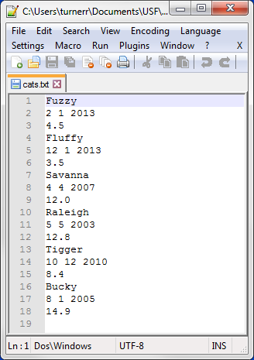
Sample Input File
Name
Date of Birth
Weight
http://www.cse.usf.edu/~turnerr/Object_Oriented_Design/Downloads/2016_01_29/Project_2_Sorting_Cats/ File cats.txt

Slide 6
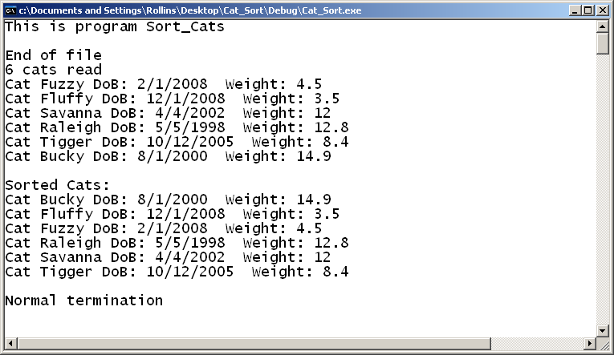
Sample Output

Slide 7
Development Environment
You may develop your program on any system you like.
But you should test the finished program on Circe.
The same source file should compile and run on either Windows or Linux.

Slide 8
Ground Rules
You may work with one other person.
OK to work alone if you prefer.
If you do work as a pair
Work together!
Both members are expected to contribute.
Submit a single program.
Both members should understand work in detail.
Do not share your code with other students.
Before or after submitting the project.
It is OK to discuss the project.
Do not copy any other student’s work.
Don’t look at anyone else’s code
Don’t let anyone look at your code.

Slide 9
Ground Rules
Except for code posted on the class web site
Do not copy code from the Internet
or any other source.
Write your own code.

Slide 10
Submission
Project is due by 11:59 PM, Thursday Feb. 4.
Deliverables:
Source code only.
Three files: main.cpp (Main Program),
Cat.h, Cat.cpp
Zip your files and submit the zip file using the Canvas Assignment for this class.
If you work with another student, include both names in the assignment comments.
Other student should submit just a Canvas comment including both names.
End of Presentation

